Slide 1
Logistic regression
Kavya Naveen Kumar
C00223350
Institute of technology Carlow

Slide 2
What is logistic regression?
Logistic regression is similar to linear regression, except that it predicts whether our chosen target variable is true or false, i.e., it is used to predict categorical variable, unlike linear regression model which predicts continuous data.
logistic regression fits an "S" shaped logistic function. Although logistic regression tells the probability that the given target variable is true or false, it commonly used for classification.

Slide 3
Introduction to the dataset: IBM employee attrition dataset
Attrition means losing employees as well as talent. As employees leave an organization, they take with them much-need skills and qualifications that they develop during his tenure. It is expensive from the company point of view to train the new employee.
If an employee you have invested so much time and money parts for a better opportunity, then this would mean that you would have to spend more time and money to hire somebody else. Therefore with the help of predictive modellings like logistic regression and we see if we can predict employee attrition on this synthetically created IBM dataset.

Slide 4
Research Questions:
1. Can we analyse the various factors which lead an employee to turnover using regression model?
2. Is it work related factors or non-worked related factors which drives employees to quit the job?

Slide 5
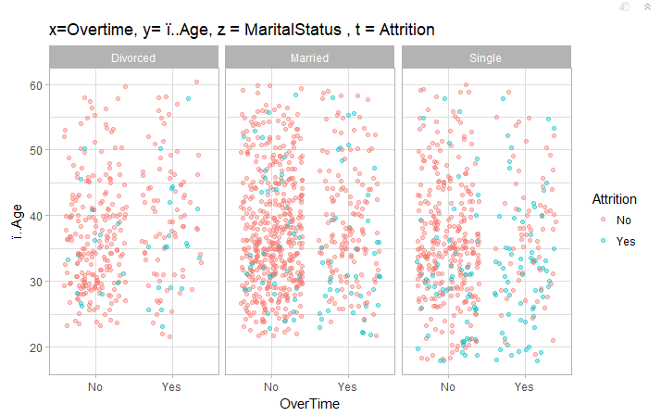
Exploratory data analysis

Slide 6
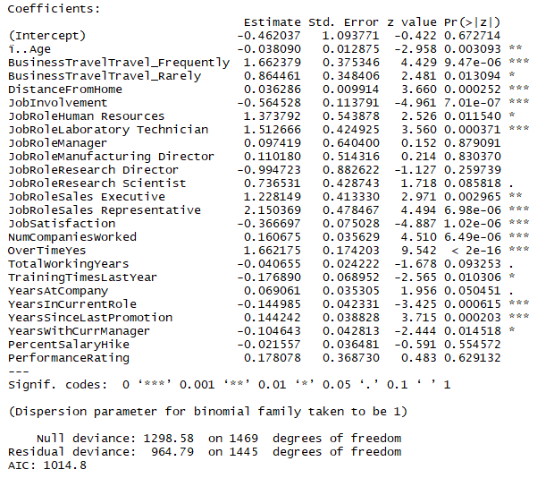
Model1 : Work related variables

Slide 7
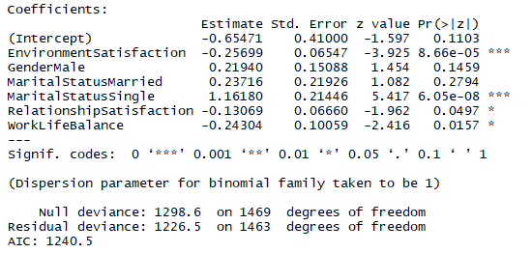
Model2: Non-work related variables

Slide 8
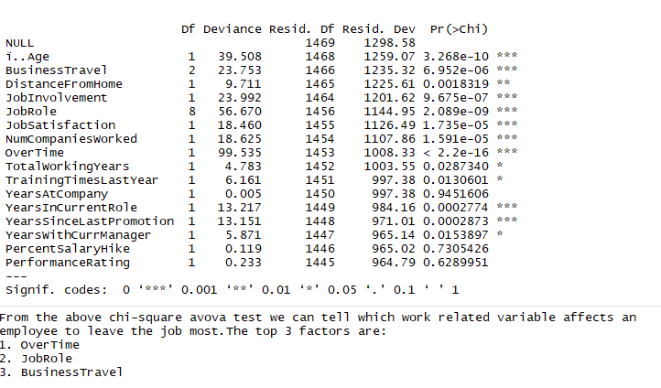
Anova for model1

Slide 9
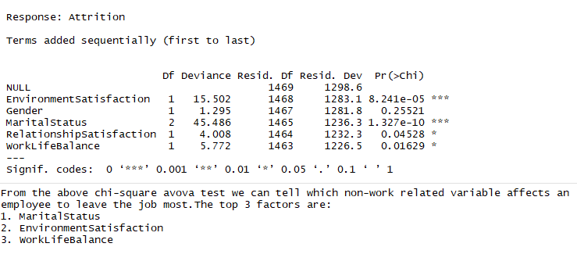
Anova for model2

Slide 10
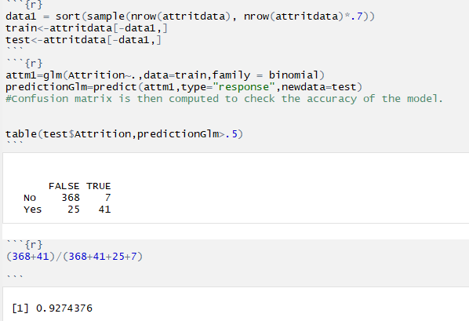
Validation

Slide 11
Conclusion
After comparing both the models with work-related variables and non-work related variables we can conclude that work-related variable affects the employees more.
From the analysis one of the main factors which drives the employees towards attrition is overtime. It is crucial for any individual to have a balanced work life. Working late hours in the office affects his/her personal life, mental and physical health too.
From the exploratory analysis, it is evident that the employees who are over 35 years and single and works late at the office are more prone to quit the job.

